Slide 1

shell scripting
part 2
Week 3
Google Slides Version

Slide 2
scripting language
Once you have the building blocks of the language (variables, loops, functions), you can approach scripting just like any other programming language.

Slide 3
running scripts
Shebang - don’t forget this first line!
Once you’ve written a script, save it and then make it an executable file using chmod +x my_script.sh
Run it using ./my_script.sh

Slide 4
running scripts: command line arguments
You can access command line arguments as variables. For example, if you run a program with:
./sample_script 1 2 3 4 5 6 7 8 9 10
Arguments 1 - 9 can be accessed in your script as $1 to $9. However, 10 cannot be accessed in the same way - after the ninth argument, you must access it using curly braces, as ${10}. This is because $10 will evaluate as $1 plus the literal number 0

Slide 5
variables, again
Variables in bash are, by default, strings.
To get arithmetic expressions, enclose them with $((...))
my_numerical_var=$((1+1))

Slide 6
built-in variables
Besides the command-line argument variables $1-$9, we also have a few other variables that are pre-assigned for common values we might want in our script.
$# → number of arguments given on the command line
$? → exit status of last command

Slide 7
if loops
if condition
then
statements-if-true-1
[ elif condition
then
statements-if-true-2
... ]
[ else
statements-if-all-else-fails ]
fi

Slide 8
conditions
Note the use of spaces between brackets and comparisons - necessary!
Note that there are flags (like -f, checking if file exists and is regular file), that work as conditions
To invert a condition, use ! :
if [ ! -f regular_file ];
Condition flags that might be useful: -L (check if symbolic link), -n (check if following string is not empty), -a (check if file exists), -d (check if file exists and is directory), -r (file exists and we have permission to read it)

Slide 9
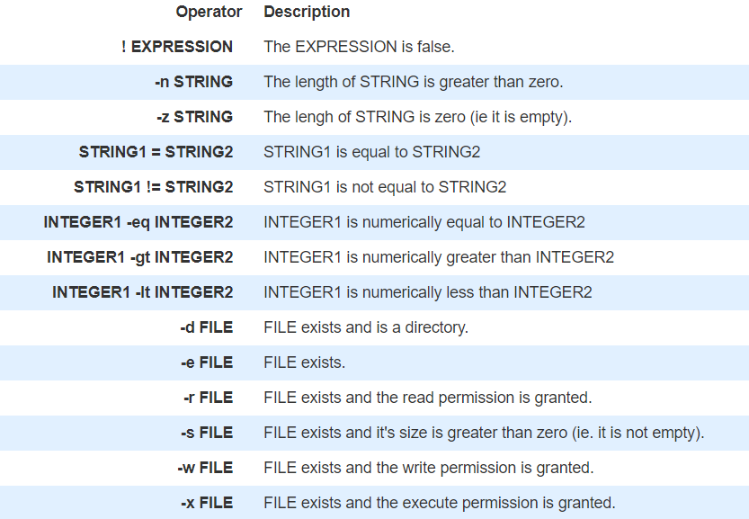
conditions
Numerical comparisons are done with phrases like -eq, -gt, etc. String comparisons are done with operators ==, >, etc.
Chart taken from here

Slide 10
if example
if grep pattern myfile > /dev/null
then
... Pattern is there
else
... Pattern is not there
fi

Slide 11
case statement
case $1 in
-f)
... Code for -f option
;;
-d | --directory) # long option allowed
... Code for -d option
;;
*)
echo $1: unknown option >&2
exit 1 # ;; is good form before `esac', but not required
esac

Slide 12
for loops
for i in atlbrochure*.xml
do
echo $i
mv $i $i.old
sed 's/Atlanta/&, the capital of the South/' < $i.old > $i
done

Slide 13
while and until loops
while condition
do
statements
done
until condition
do
statements
done

Slide 14
functions
Must be defined before they can be used. Can be done either at the top of a script or by having them in a separate file and source them with the “dot” (.) command. Cannot return values!
my_func ( ) {
…
}
my_func
my_func 10

Slide 15
IFS
Internal Field Separator → the value by which bash decides how to split up output into different elements.
The default is whitespace, but we can change it by re-assigning it like any other variable. (And we will want to reassign it for this assignment).

Slide 16
assignment 3: hw hints
Check the Assignment 3 Hints slides found on CCLE, Week 3 first when you’re starting. If you’re stuck on any step, check there first!
You’re asked to do a recursive and non-recursive case. Get the non-recursive working first, as it is the bulk of the work!
If you’re working efficiently, the recursive case should just be one added line: using find with -exec option to execute your script on every directory you find
My suggested pace is: get the set-up and checking if valid call to script or not out of the way first, then work on recognizing poor names non-recursively through regex, then modify your script to do it recursively
Check your regex on an outside source/website first before putting it in your script.

